Slide 1



Data
Culture
Society
We support, facilitate, promote and inspire data-led and applied digital research across the arts, humanities and social sciences.
@edCDCS
Notes:
MT

Slide 2
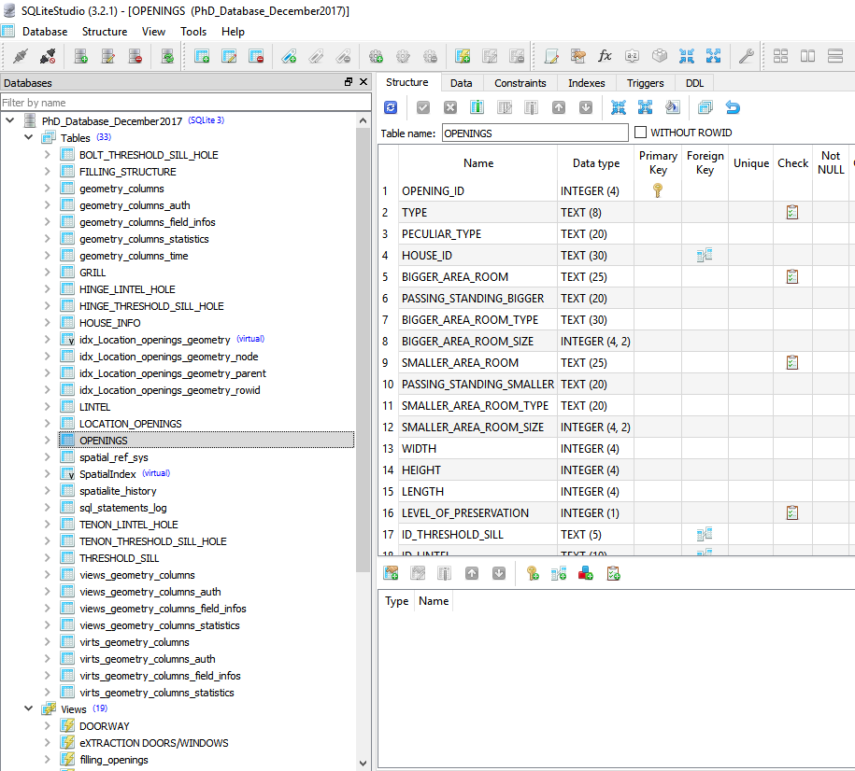
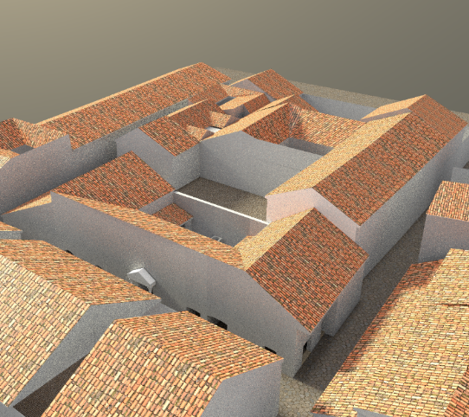
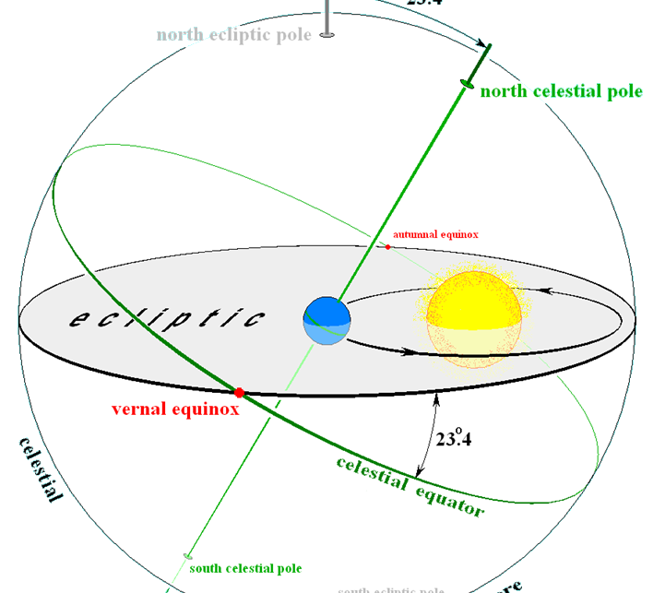

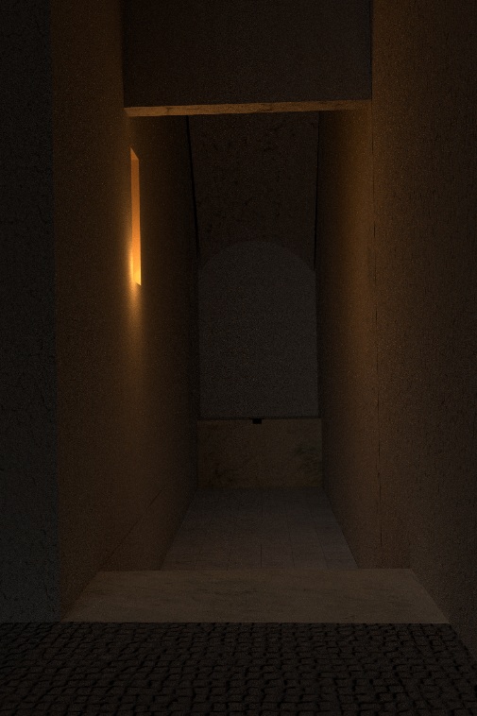
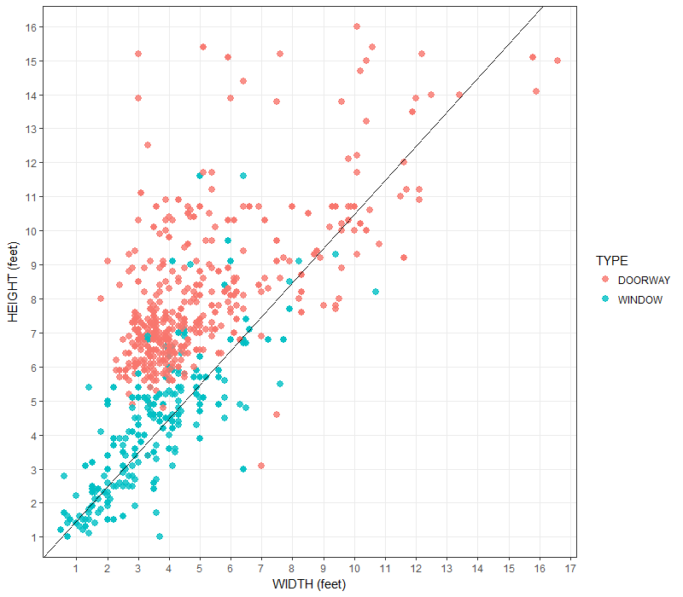

Before starting …
Who am I
I obtained a Phd in Classic from UEd
Training Programme manager for CDCS
www.cdcs.ed.ac.uk

Slide 3

Programme of TOday
10:00 – 10:10: Intro
10:10 – 12:00: Part 1
12:00 – 12:45: Lunch Break
12:45 – 14:15: Part 2
14:15 – 14:30: Coffee Break
14:30 – 16:00: Part 3
www.cdcs.ed.ac.uk
Notes:
MT

Slide 4
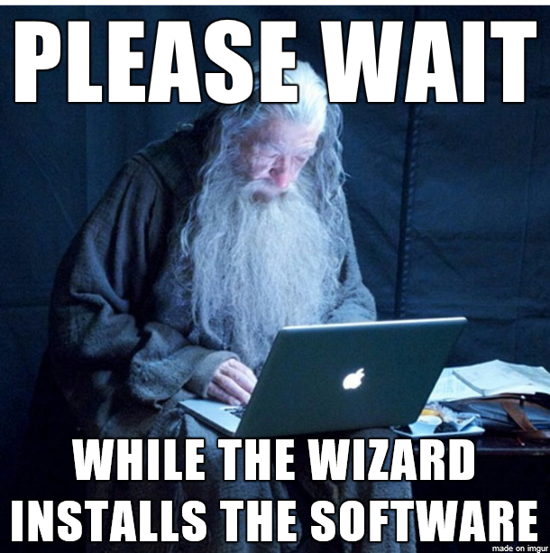
Before we Start
Do you all have R and R Studio installed and ready to go? Or alternatively are you logged into Noteable?
Memegenerator.net
www.cdcs.ed.ac.uk

Slide 5


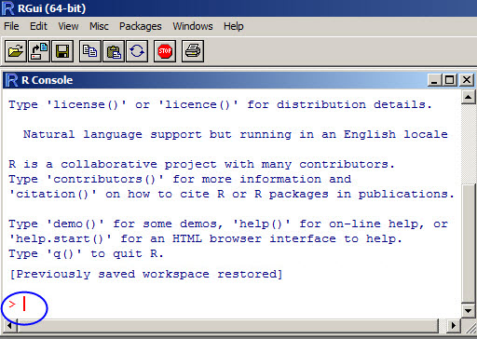
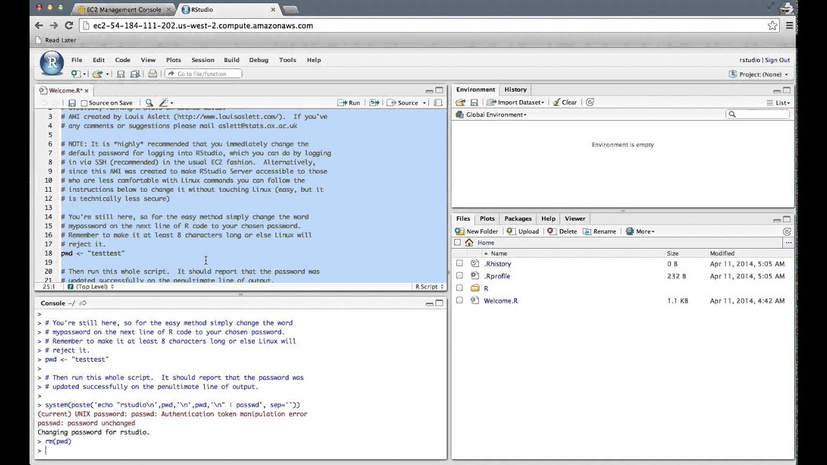
R and R Studio
RStudio is the most popular IDE (Integrated Development Environment) for R.
An IDE is a piece of software that provides tools to make programming easier
R refers to both the Programming Language and the Software that interprets the R scripts
Language
Interface
www.cdcs.ed.ac.uk

Slide 6
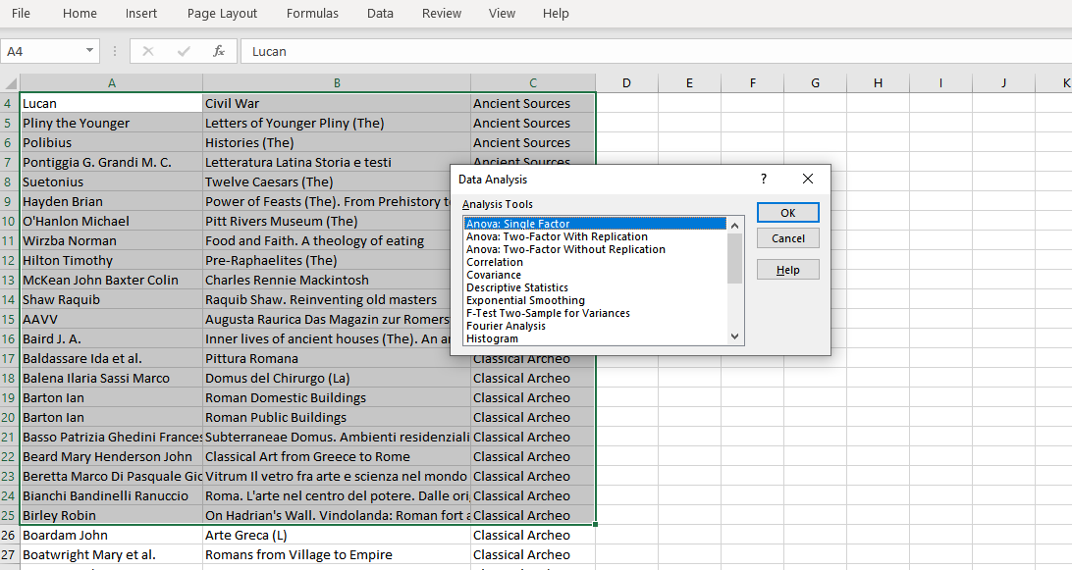
Why not use Excel for Graphs
Impossible to trace back your steps
Need to redo every-step for every analysis (time consuming)
If you need to get back and modify one passage everything needs to be re done
Mostly this is not what is meant to do
www.cdcs.ed.ac.uk

Slide 7
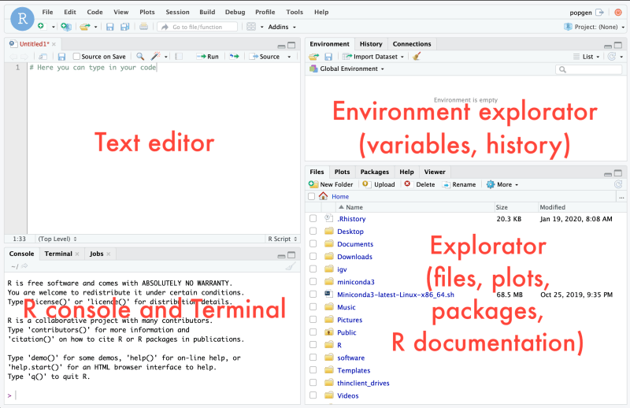
R Studio interface
www.cdcs.ed.ac.uk

Slide 8
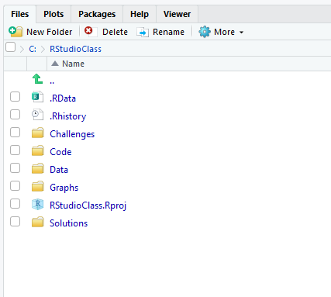
R Studio workspace
Your workspace shall look something like this
A project folder
Within the folder a series of subfolders: Challenges, Code, Data, Graphs, Solution
A Rstudio project file
A .Rdata file and a .Rhistory file (both generated authomatically by the system
www.cdcs.ed.ac.uk

Slide 9
R Studio interface
Data types
Vector: monodimential (either a column or a row) One dimentional collection of data
Matrix: bidimential collection of data
Array: multidimentional collection of data
Data frame: different type variables (similar to a table in spreadsheet)
Reading a Table
Variables: The attributes of our dataset basically the Column
Observations: Measurements carried out in one or more individuals, based on one or more variables
www.cdcs.ed.ac.uk

Slide 10
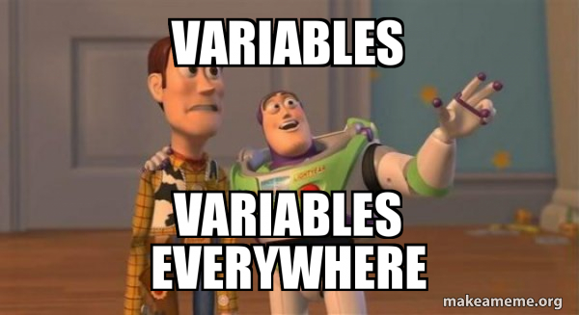
TYPE of Variables
Categorical variables
Defined and limited values, might not have a logical order
Material: bronze, iron, ivory
Color: blu, red, white
Discrete variables
numeric variables that have a countable number of values between any two values. A discrete variable is always numeric
Number of attendees
Centuries
Continuous variables
Numeric variables that have an infinite number of values between any two values
Diameter
Lenght
www.cdcs.ed.ac.uk

Slide 11
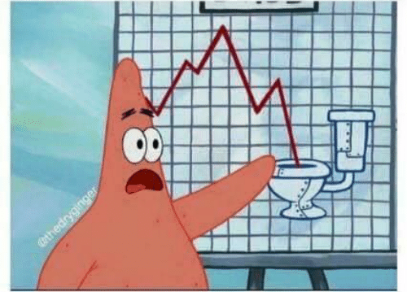
Before plotting…think to what you want to convey
Analyse one variable (is it constant, does it have one or more peaks)?
Tell a story (what do you think your data can tell)?
Show a relation between two variables?
Suggest a trend?
Show a change (across time, across space, etc)?
https://datavizcatalogue.com/
www.cdcs.ed.ac.uk

Slide 12
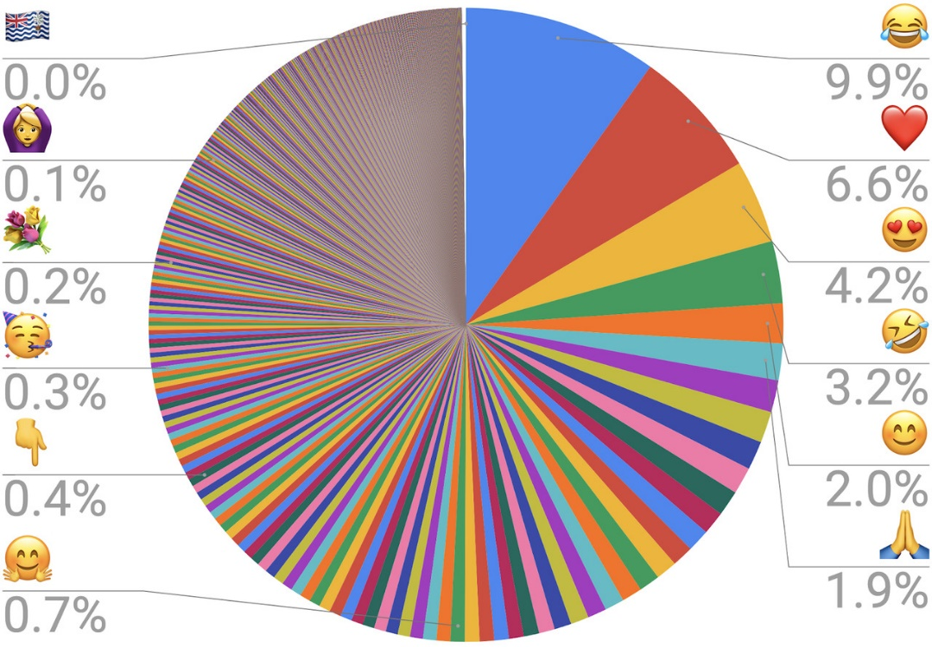
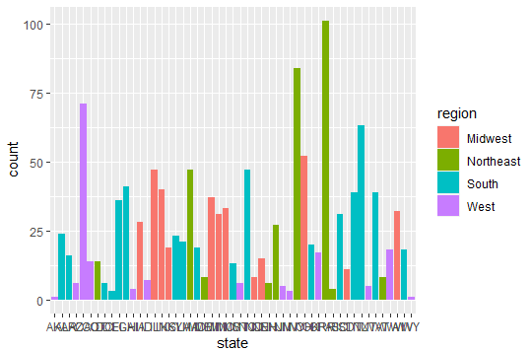

Consider the medium
Will it be printed? Visualized online…?
How big will it be?
How can I improve the understanding?
www.cdcs.ed.ac.uk

Slide 13
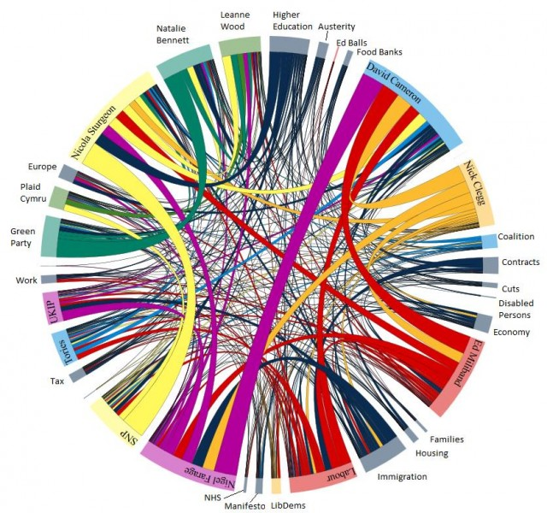
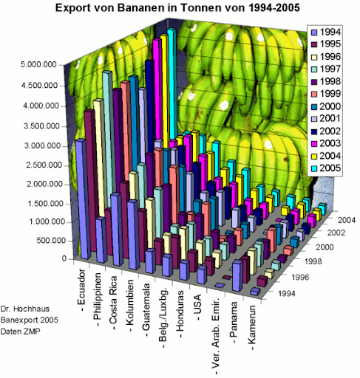
Avoid showing off
https://rafalab.github.io/dsbook/data-visualization-principles.html
www.cdcs.ed.ac.uk

Slide 14
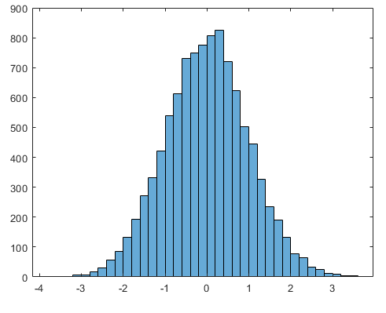
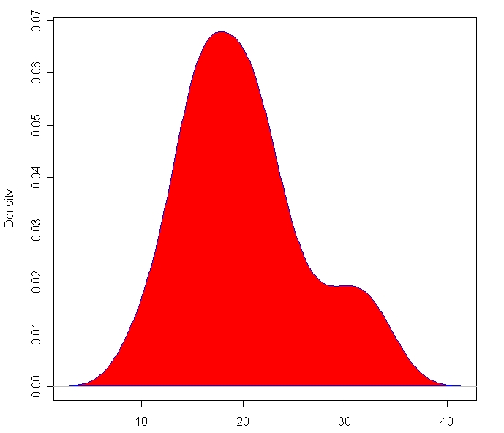
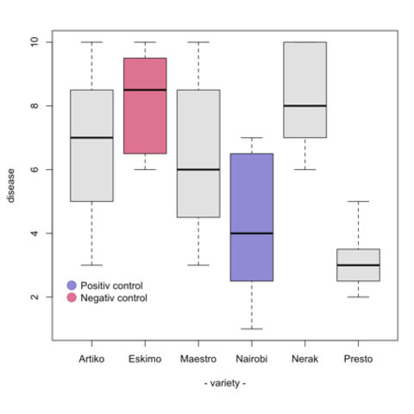
distribution
Histogram
Density Plot
Boxplot
www.cdcs.ed.ac.uk

Slide 15
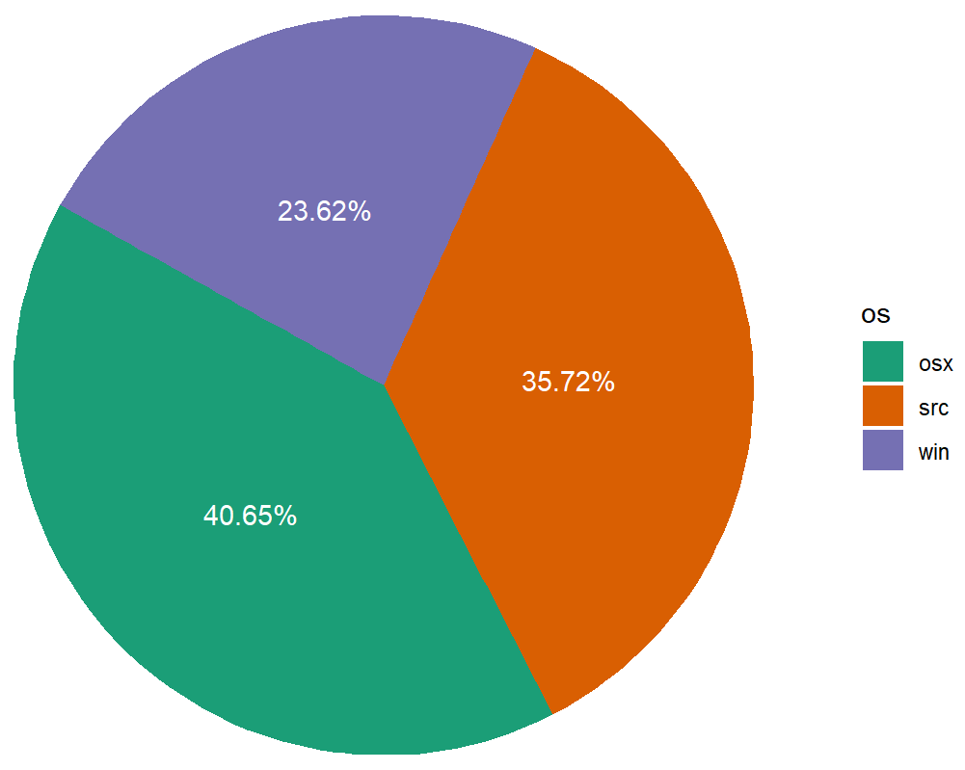
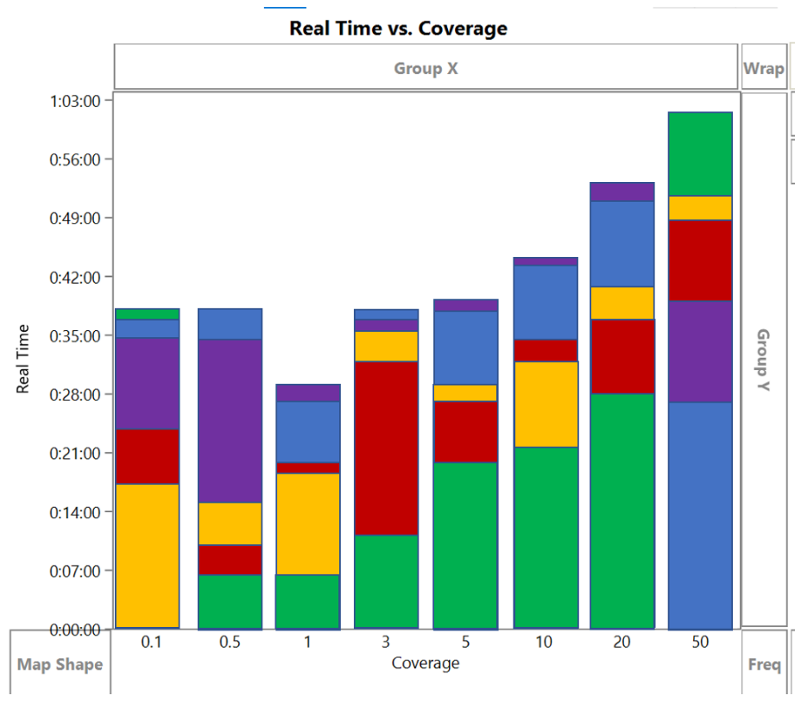
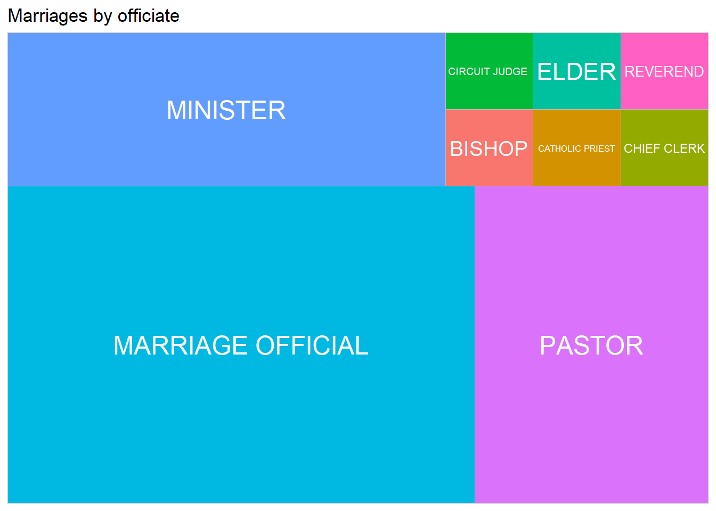
RATIO
Piechart
Stacked bar graph
Treemap
www.cdcs.ed.ac.uk

Slide 16
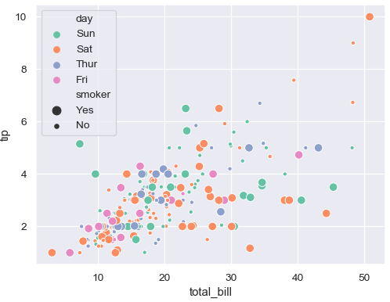
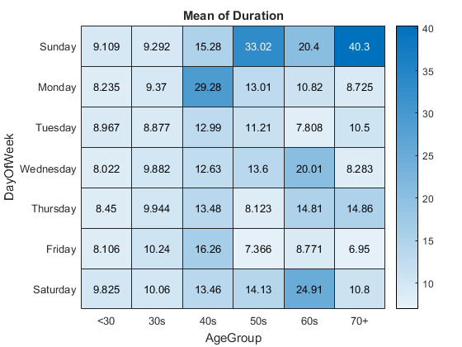
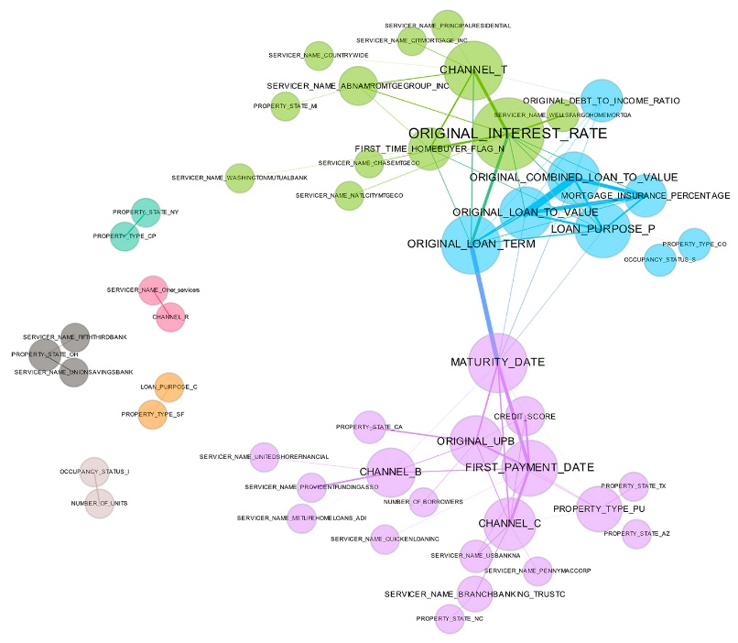
relations
Scatter plot
Heatmap
Network diagram
www.cdcs.ed.ac.uk

Slide 17
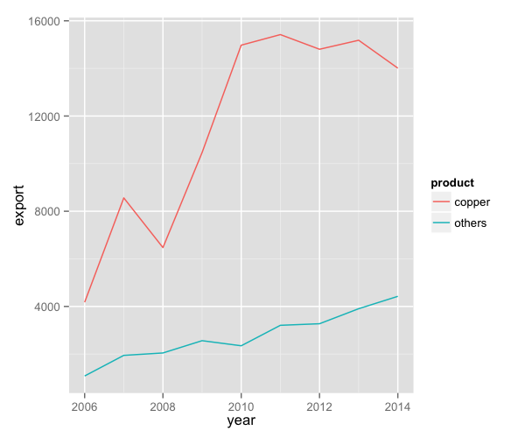
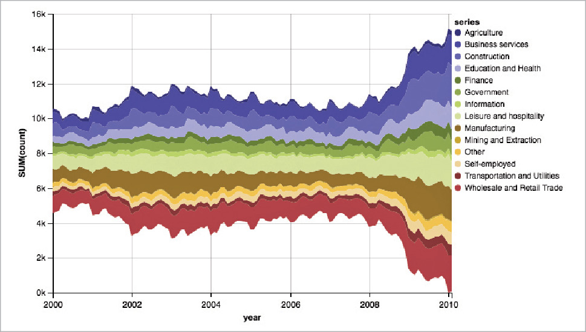
change
Line graph
Stream graph
www.cdcs.ed.ac.uk

Slide 18
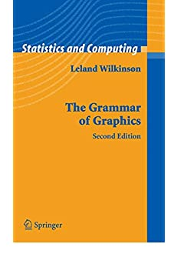
The grammar of Graphics
Sentences are elegant compositions of carefully chosen grammatical elements that convey precise and clear messages
Visualisations are elegant mapping of data onto the right visual encondings to tell a story
By Leland Wilkinson
www.cdcs.ed.ac.uk

Slide 19
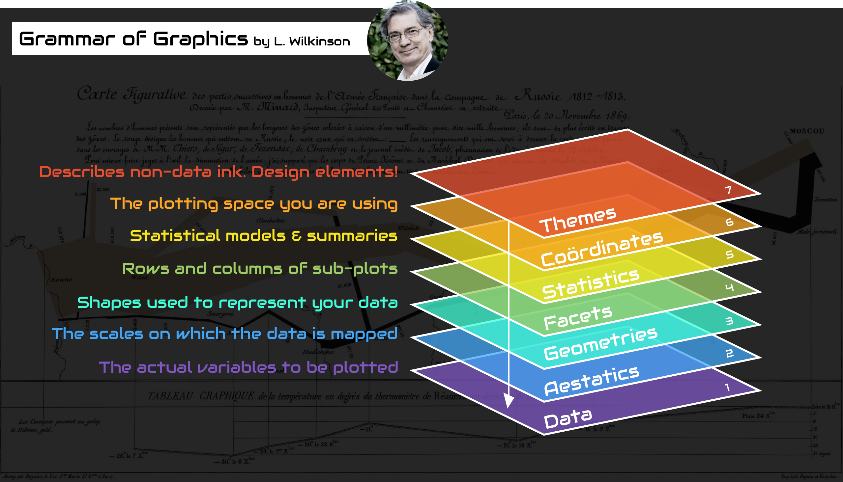
www.cdcs.ed.ac.uk

Slide 20
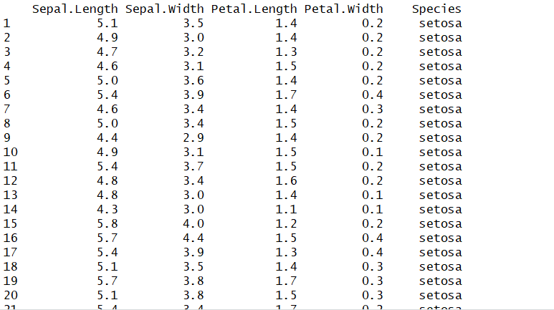
The data
Level 1: The Dataset I am using
If I want to plot the same type of chart with different data all you have to change is the data reference in the code
www.cdcs.ed.ac.uk

Slide 21
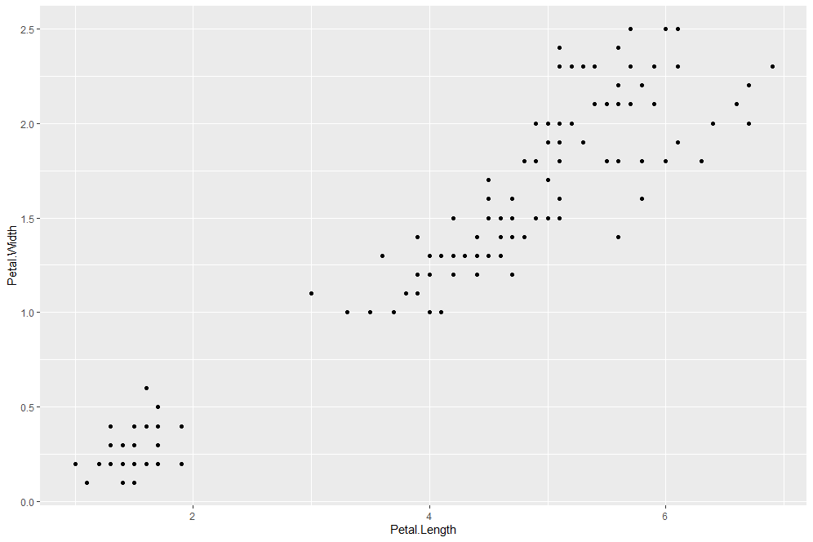
Aesthetic and geometries
Level 2 and 3
Aesthetics identify which variables I want to work on (depending on the type of chart you are going to work on one or more variables)
Geometries identify the type of chart that I want to produce.
ggplot(iris, aes(x=Petal.Length, y=Petal.Width)) + geom_point()
www.cdcs.ed.ac.uk

Slide 22
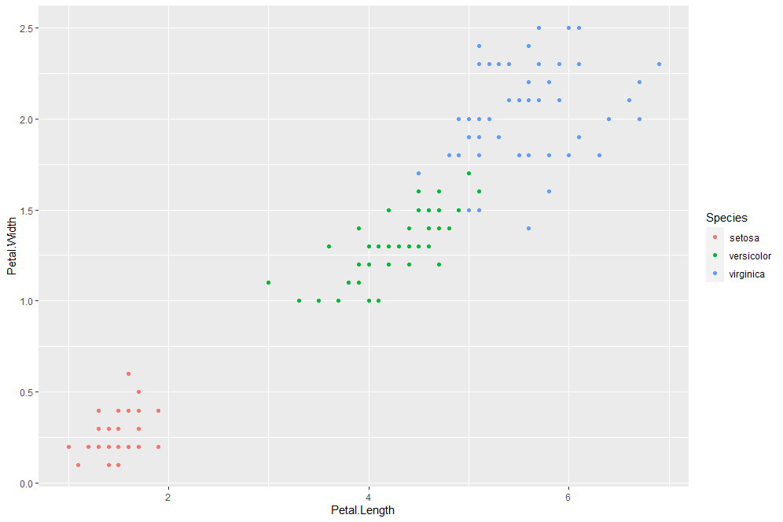
aesthetic
Level 2
Aesthetics Add a third colour coded variable. Since it is still linked to the aesthetics I need to set it within that part of the code
ggplot(iris, aes(x=Petal.Length, y=Petal.Width, color=Species)) + geom_point()
www.cdcs.ed.ac.uk

Slide 23
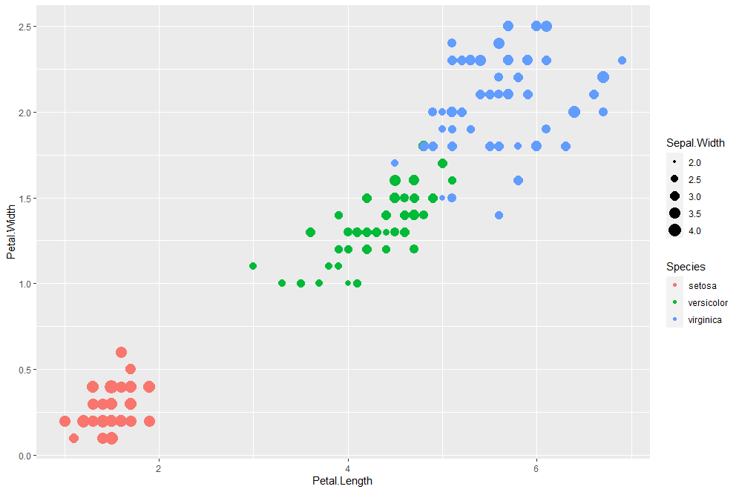
aesthetic
Level 2
Aesthetics Add a fourth size coded variable. Since it is still linked to the aesthetics I need to set it within that part of the code
ggplot(iris, aes(x=Petal.Length, y=Petal.Width, color=Species, size=Sepal.Width)) + geom_point()
www.cdcs.ed.ac.uk

Slide 24
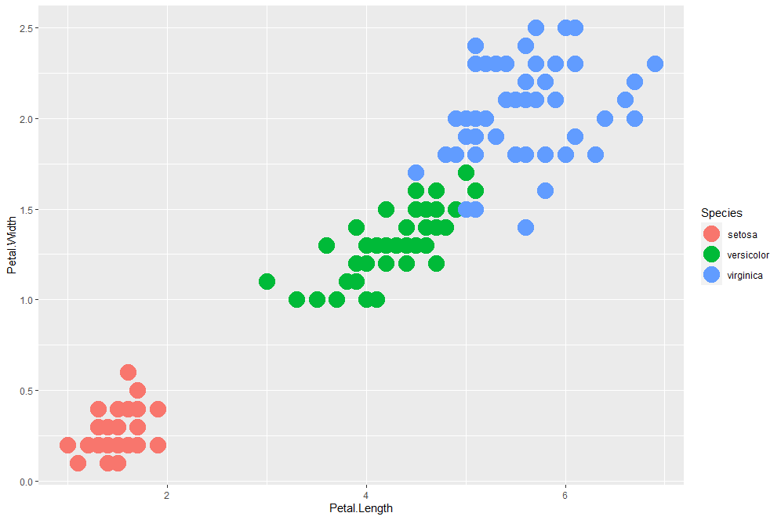
GEometry
Level 3
Geometry. If I just want all the dots to be bigger I shall set the value in the geometry part of the code.
ggplot(iris, aes(x=Petal.Length, y=Petal.Width, color=Species)) + geom_point(size=7)
www.cdcs.ed.ac.uk

Slide 25
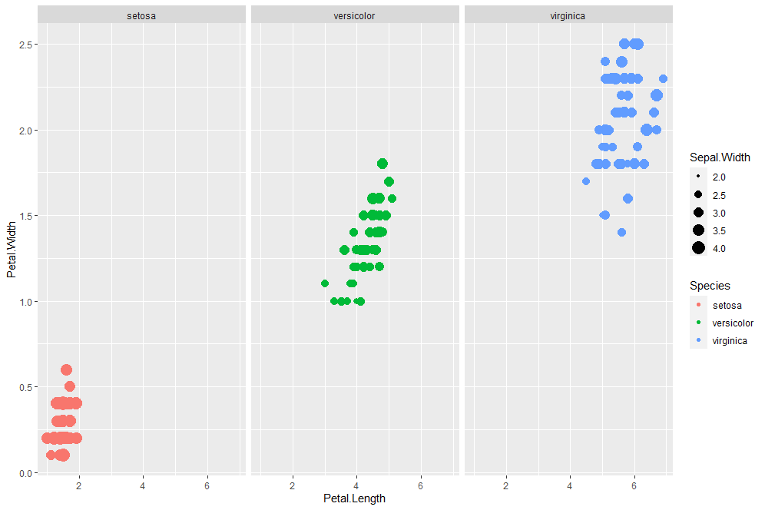
facet
Level 4 Subplot
Facet. If I just want to visualise the results on separate subplot you need to add this new level of information
ggplot(iris, aes(x=Petal.Length, y=Petal.Width, color=Species, size=Sepal.Width)) + geom_point()+facet_wrap(~Species)
www.cdcs.ed.ac.uk

Slide 26
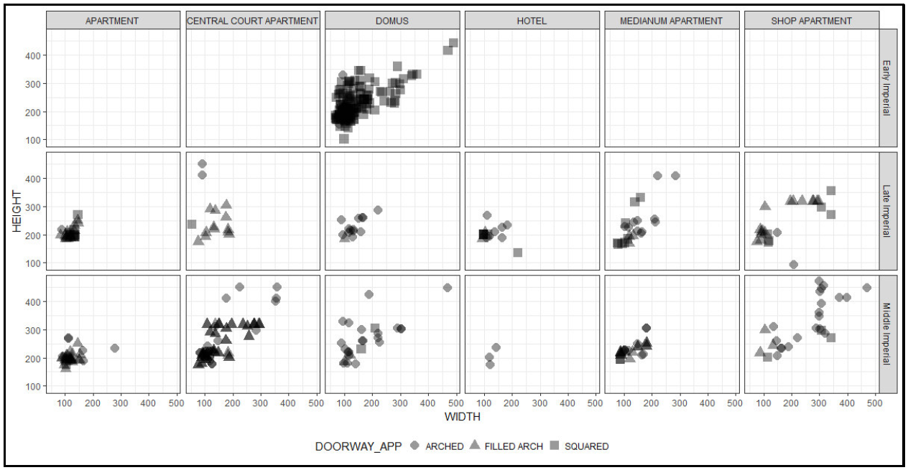
facet
Level 4 Subplot
Facet. If I just want to visualise the results on separate subplot you need to add this new level of information
If you want to subplot across 2 different variables use facet_grid
ggplot(iris, aes(x=Petal.Length, y=Petal.Width, color=Species, sizcie=Sepal.Width)) + geom_point()+facet_grid(Petal.Width~Spees)
www.cdcs.ed.ac.uk

Slide 27
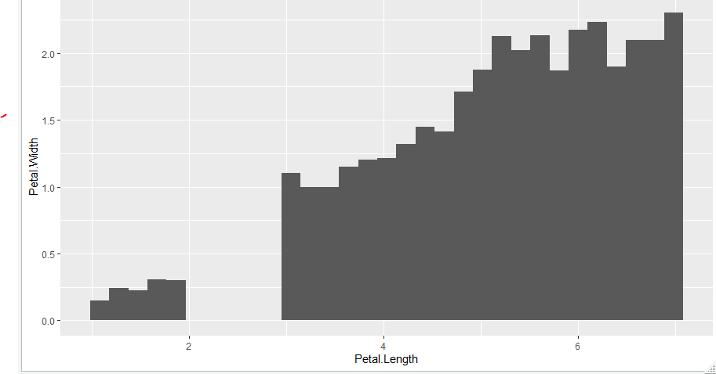
statistics
Level 5 Summarizing Stats
Instead of the data if you want to plot the summarising of those data you do so using the stats level
ggplot(iris, aes(x=Petal.Length, y=Petal.Width)) + stat_summary_bin(fun.y="mean", geom = "bar")
www.cdcs.ed.ac.uk

Slide 28
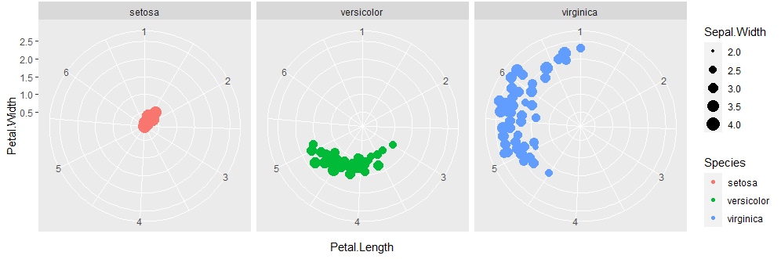
coordinates
Level 6 Coordinates
On this level you can set the attributes of the coordinates, change the scale or transform in polar
ggplot(iris, aes(x=Petal.Length, y=Petal.Width, color=Species, size=Sepal.Width)) + geom_point()+facet_wrap(~Species)+coord_polar()
www.cdcs.ed.ac.uk

Slide 29
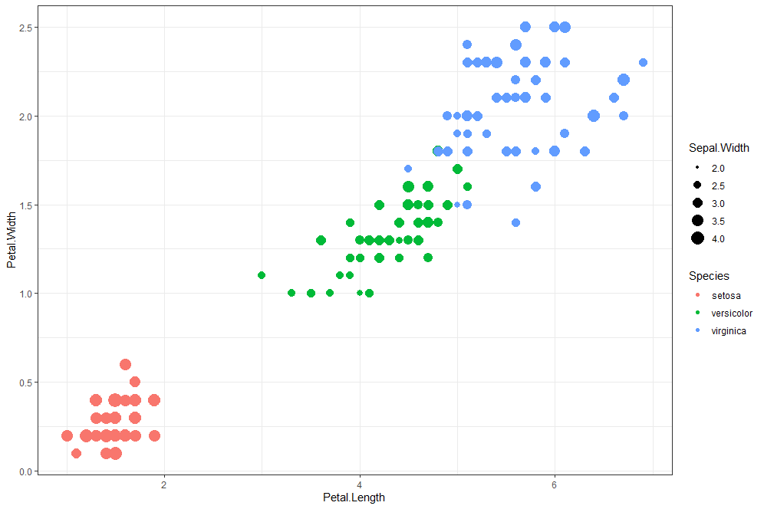
themes
Level 7 Global settings
Global settings of the charts can be changed in the theme part of the code. All non data ink
ggplot(iris, aes(x=Petal.Length, y=Petal.Width, color=Species, size=Sepal.Width)) + geom_point()+theme_bw()
www.cdcs.ed.ac.uk

Slide 30
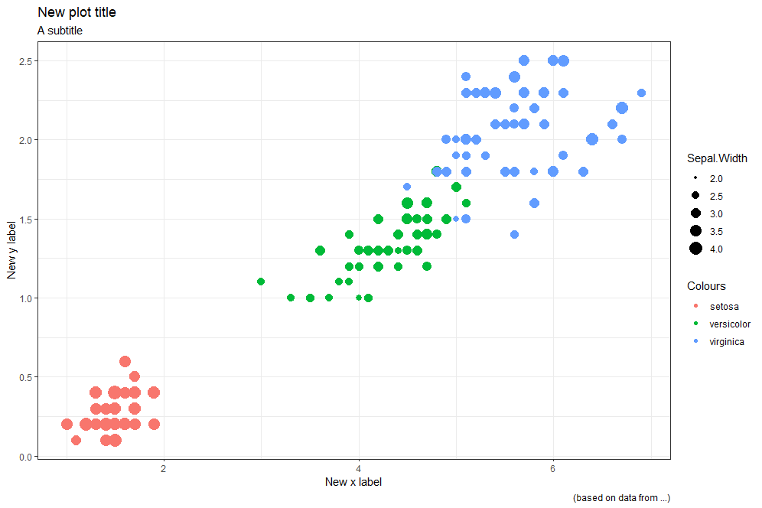
labels
Level 7 labels
A peculiar setting you want to pay attention to are the lables
ggplot(iris, aes(x=Petal.Length, y=Petal.Width, color=Species, size=Sepal.Width)) + geom_point()+theme_bw() + labs(title = "New plot title", subtitle = "A subtitle", caption = "(based on data from ...)", x = "New x label", y= "New y label", color = "Colours")
www.cdcs.ed.ac.uk

Slide 31
distribution
Histogram
Density Plot
Boxplot
www.cdcs.ed.ac.uk

Slide 32
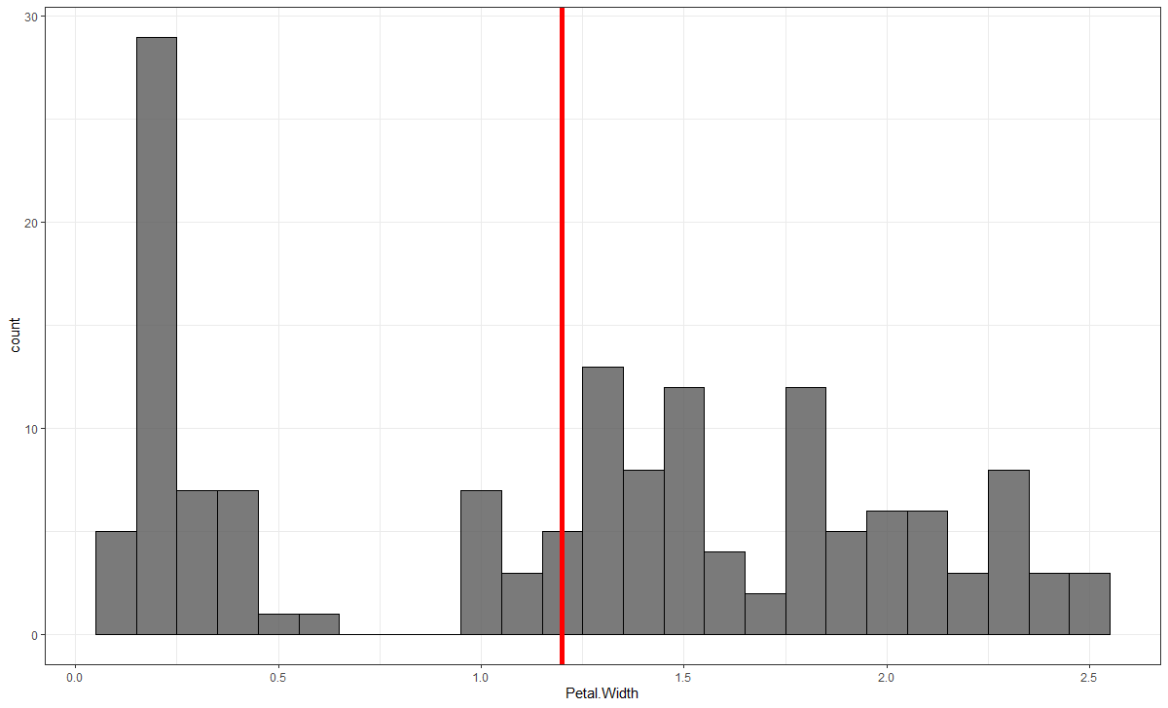
Visualise the distribution: Histogram and Density plots
A histogram is an approximate representation of the distribution of numerical or categorical data.
geom_histogram
www.cdcs.ed.ac.uk

Slide 33
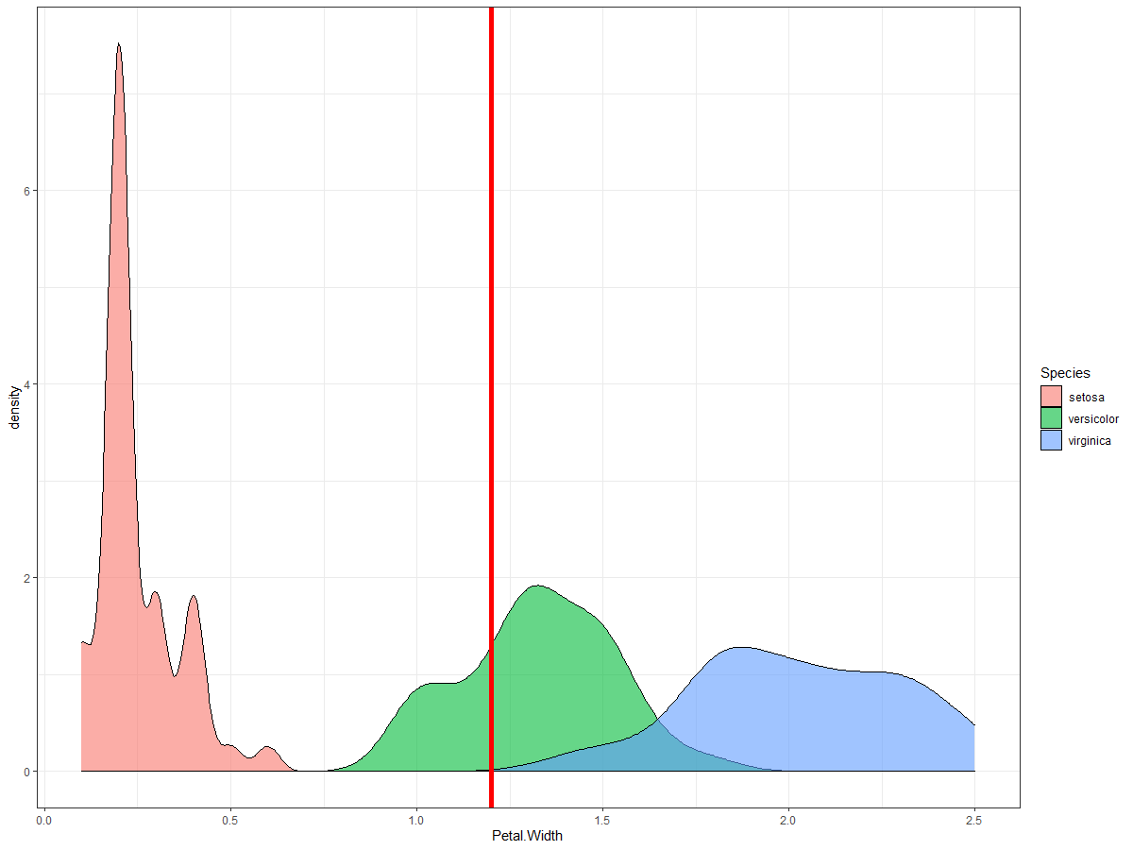
Visualise the distribution: Histogram and Density plots
A density plot is a representation of the distribution of a numeric variable. It uses a kernel density estimate to show the probability density function of the variable. It is a smoothed version of the histogram and is used in the same concept.
geom_density
www.cdcs.ed.ac.uk

Slide 34
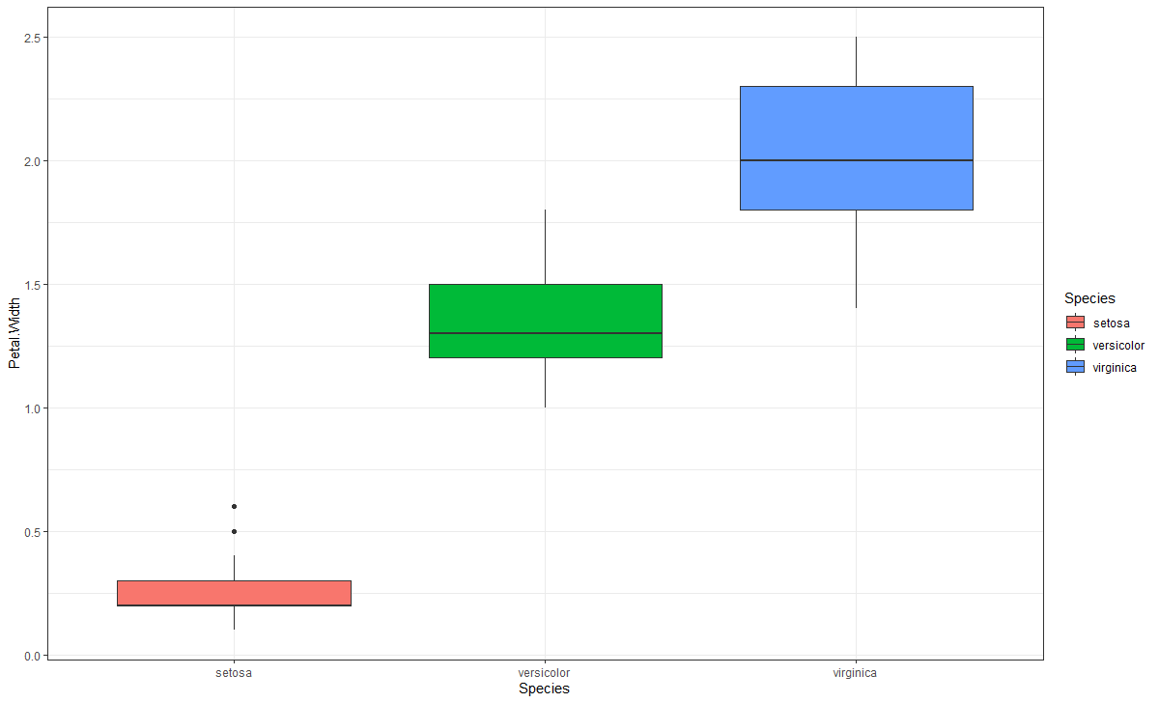
BOXPlots
The thick black line is the median.
The boxes represent 50% of the sample closest to the median
The whiskers correspond to 95% of the sample closest to the median aka 2SD from the median
The dots represent the outliers
www.cdcs.ed.ac.uk

Slide 35
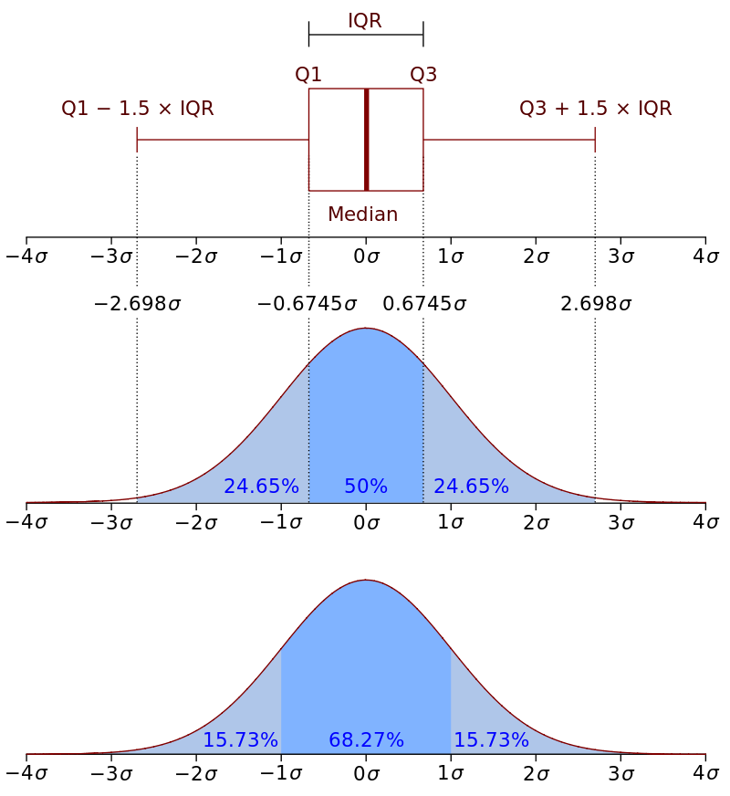
boxplot
The outliers are all the value below or above 1.5* the interquartile range from Q1 and Q3
By adding a + geom_jitter(size= 4, alpha =0.3) you can add the information of the single observations
You cand add the mean information by create a means dataframe using the aggregate command And then use stat_summary and geom_text commands
www.cdcs.ed.ac.uk

Slide 36
RATIO
Piechart
Stacked bar graph
Treemap
www.cdcs.ed.ac.uk

Slide 37
Why Pie Charts are not a good idea
Humans are pretty bad at reading angles
Similar percentage slices would be virtually impossible to distinguish
Many journals will scored your article lower
https://www.data-to-viz.com/caveat/pie.html
www.cdcs.ed.ac.uk

Slide 38
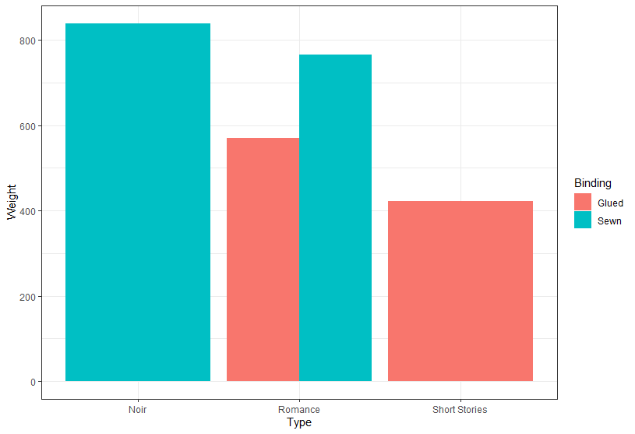
Grouped stacked and percent stacked barcharts
Bar charts are graph that present categorical data with bars with heights or lengths proportional to the values that they represent.
The bars can be plotted vertically or horizontally
Variables Needed
1 or 2 categotical variables for x and color
Y axis
Continuous variable
Use count of a Categorical variable
www.cdcs.ed.ac.uk

Slide 39
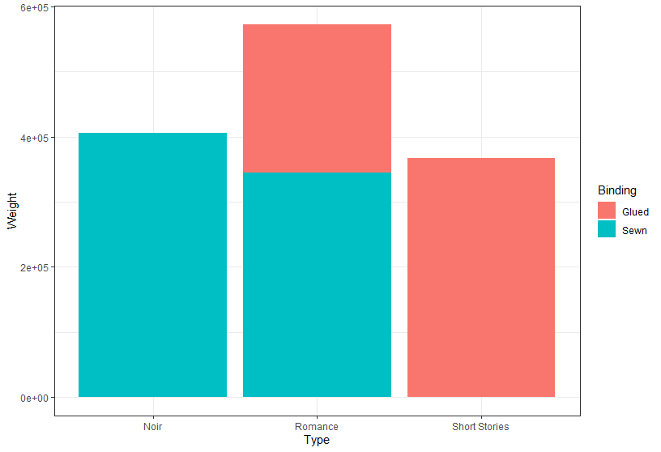
stacked barcharts
Stacked Barplot
ggplot(BooksR, aes(fill=Binding, y=Weight, x=Type)) +
geom_bar(position="Stack", stat="identity")+theme_bw()
www.cdcs.ed.ac.uk

Slide 40
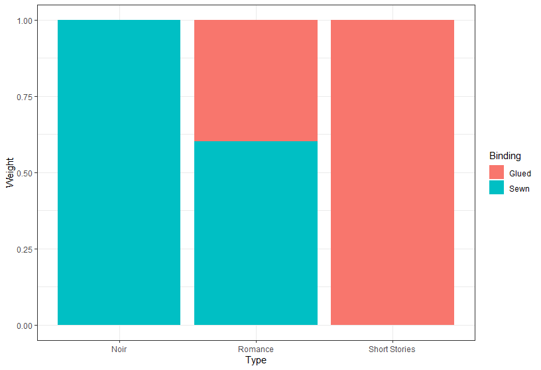
Stacked Barplot using percentage
Use the percentage of the continuous variable
ggplot(BooksR, aes(fill=Binding, y=Weight, x=Type)) +
geom_bar(position="fill", stat="identity")+theme_bw()
www.cdcs.ed.ac.uk

Slide 41
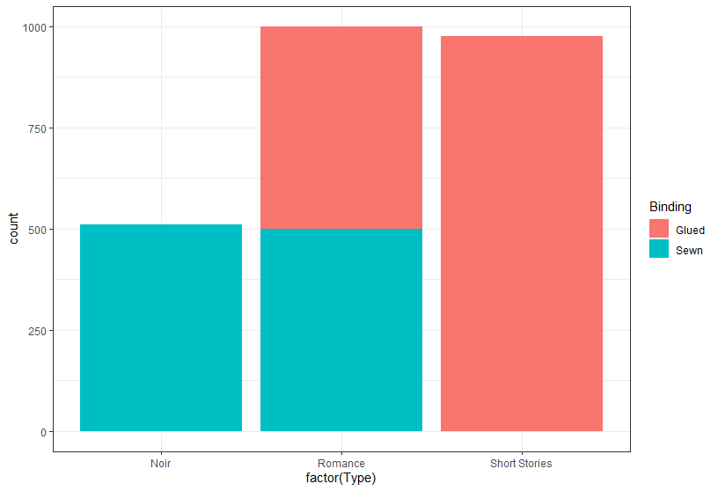
Stacked Barplot using count categorical variable
Use the count of the «Type» observations
ggplot(BooksR, aes(x=factor(Type), fill=Binding)) +
geom_bar()+theme_bw()
www.cdcs.ed.ac.uk

Slide 42
Grouped, stacked and percent stacked barcharts
Bar charts are graph that present categorical data with bars with heights or lengths proportional to the values that they represent.
The bars can be plotted vertically or horizontally
Variables Needed
1 or 2 categotical variables for x and color
Y axis
Continuous variable
Use count of a Categorical variable
www.cdcs.ed.ac.uk

Slide 43
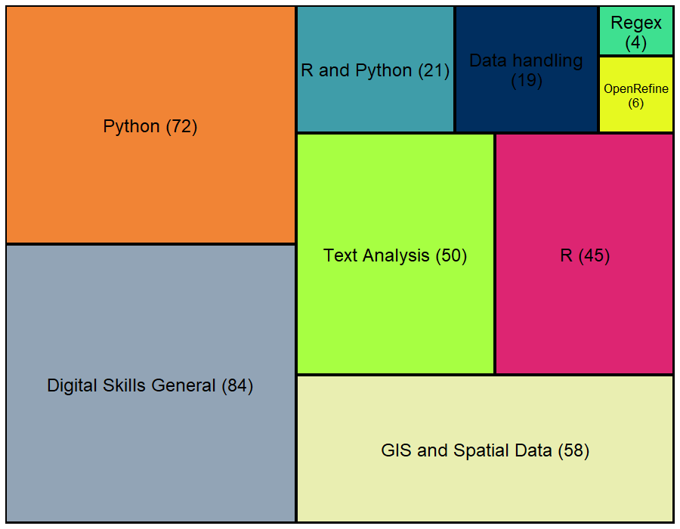
Treemap
Humans are pretty bad at reading angles
Similar percentage slices would be virtually impossible to distinguish
www.cdcs.ed.ac.uk

Slide 44
relations
Scatter plot
Heatmap
Network diagram
www.cdcs.ed.ac.uk

Slide 45

HEATMAP
ggplot(college, aes(x=control, y=region))+ geom_bin2d() +theme_bw()
www.cdcs.ed.ac.uk

Slide 46

Network DIagram
Way more complex than what we can cover here
You need network data
Good place to start https://briatte.github.io/ggnet/
www.cdcs.ed.ac.uk

Slide 47
change
Line graph
Stream graph
www.cdcs.ed.ac.uk

Slide 48

LINE gRAPH
Useful when you need to plot the evolution of your variable
Caveat: it needs to be use for something that has an evolution
www.cdcs.ed.ac.uk

Slide 49

STREAM gRAPH
What you need
a numeric variable for the X axis. Usually it provides time.
a numeric variable for the Y axis: this is the variable we are studying
a categorical variable: each group will be plotted as a distinct shape
www.cdcs.ed.ac.uk

Slide 50

Other Graphs
www.cdcs.ed.ac.uk

Slide 51

2D density Plots
geom_density_2d
ggplot(college, aes(x=sat_avg, y=admission_rate, color=region)) + geom_point(alpha=0.5)+theme_bw()+facet_wrap(~region)+ geom_density_2d()
www.cdcs.ed.ac.uk

Slide 52

Bubble Graph
ggplot(college, aes(x=region, y=control, color=region))+ geom_count() +theme_bw()+facet_wrap(~region)
www.cdcs.ed.ac.uk

Slide 53

Custumize your Graphs
www.cdcs.ed.ac.uk

Slide 54

ORDER THE RESULTS
On the fly
Add to the plot
+ scale_x_discrete(limits=c("Romance", "Short Stories", "Noir"))
In the order you want them visualised
From https://blogjunkie.net/2016/01/fastmail-rules-newsletters-contact-groups/data-sorting-lego/
www.cdcs.ed.ac.uk

Slide 55
ORDER THE RESULTS
Change the dataset
From https://blogjunkie.net/2016/01/fastmail-rules-newsletters-contact-groups/data-sorting-lego/
Make sure the variable is set as factor:
newBooks <- BooksR %>% mutate(Type = as.factor(Type))
newBooks %>%
pull(Type) %>%
levels()
Define the new order
newBooks$Type <- factor(newBooks$Type, levels(newBooks$Type)[c(2,3,1)])
In the order you want them visualised
www.cdcs.ed.ac.uk

Slide 56

colour
Color brewer Palettes
https://www.datanovia.com/en/blog/top-r-color-palettes-to-know-for-great-data-visualization/
www.cdcs.ed.ac.uk

Slide 57

colour
Wesander Palettes
https://www.datanovia.com/en/blog/top-r-color-palettes-to-know-for-great-data-visualization/
www.cdcs.ed.ac.uk

Slide 58

Colour- gray palette
You can plot everything in a gray scale by using
+ scale_color_grey(start = 0.6, end = 0.1)
Start: the lighter value
End: the darker color
www.cdcs.ed.ac.uk

Slide 59

Colour- manually change colours
You can use either the hex values (https://www.hexcolortool.com/)
or the colours names recognised by ggplot (http://sape.inf.usi.ch/quick-reference/ggplot2/colour)
You need to select a n number of colors corresponding to the number of different colours you need within a concatenate function (c)
www.cdcs.ed.ac.uk

Slide 60

Colour- continuous colours
When instead of a series of values you need a continous palette like for scatterplots you can use:
+scale_color_gradientn(colours = rainbow(7))
7: is the number of colours the system will use and rainbow is the palette
www.cdcs.ed.ac.uk

Slide 61

Remove null values
In order to perform any type of analysis on your sample you need to eliminate the Null values.
Two approaches possible
Eliminate all rows that has a null value for any of the variable: 1 Step analysis
Eliminate rows based on the single analysis performed: Doesn’t eliminate what is not needed but need more attention on number observations
www.cdcs.ed.ac.uk

Slide 62

Change Scale Axis
Define limit axis
Add
+expand_limits(x=c(0,10), y=c(0, 3))
Min and Max values
www.cdcs.ed.ac.uk

Slide 63

Change Scale Axis
Use logarithmic scale
Add
+ coord_trans(x="log", y="log")
Log is natural logarithm. Also available log10 and log2
www.cdcs.ed.ac.uk

Slide 64

Change Scale Axis
ggplot(iris, aes(x=Petal.Length/2.54, y=Petal.Width/2.54, color=Species)) + geom_point(size=6, alpha=0.5)+theme_bw()+ labs(title = "Iris", subtitle = "Relationship between Petal Lengh and Petal Width", x = "Petal Length (Inches)", y= "Petal Width(Inches)")
Calculate a on the fly equivalence
Make sure to reflect it in the legend
www.cdcs.ed.ac.uk

Slide 65

SET thicks of the grid
Smaller grid no visible number
Add
+ scale_x_continuous(minor_breaks = seq(0,3, 0.5),
breaks = seq(0,3,1))+
scale_y_continuous(minor_breaks = seq(0,2, 0.25), breaks = seq(0,2,0.5))
Major grid visible number
Seq(start, max, every how many)
www.cdcs.ed.ac.uk

Slide 66

Export your graphs
ggsave(filename='Figure1.tiff', dpi=600, path='Graph')
How I want to call it
How big
Where I am saving
www.cdcs.ed.ac.uk

